Slide 1
OUR SCHOOL UNIFORMS
A. Scian, A. Polazzo, F. Pitton, N. Pitton

Slide 2

Our Coat of Arms

Slide 3
Our Clothes
Shoes for Girls:
Nike AirForce 1 \ Nike Jordan 1\ Adidas Campus
Shoes for Boys:
Nike Jordan 4 \ Nike Jordan 11 \ Nike AirForce 1 \ Nike Jordan 1
Pants for Girls:
Shorts below the knee \ Leggins \ Baggy Jeans
Pants for Boys:
Baggy Jeans \ Baggy Pants \ Shorts below the knee

Slide 4
T-Shirt for Girls:
everything except the tops during P.E.
T-Shirt for Boys:
Everything except strange writings
Sweatshirt for Girls:
Everything except tops during P.E.
Sweatshirt for Boys:
Everything

Slide 5
Our Colors
Every color but:
No Green
No Yellow
and

Slide 6


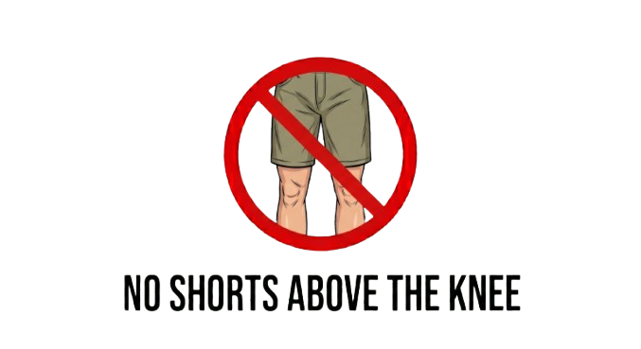




Our Rules

Slide 7
Thank you for listening

